Slide 1
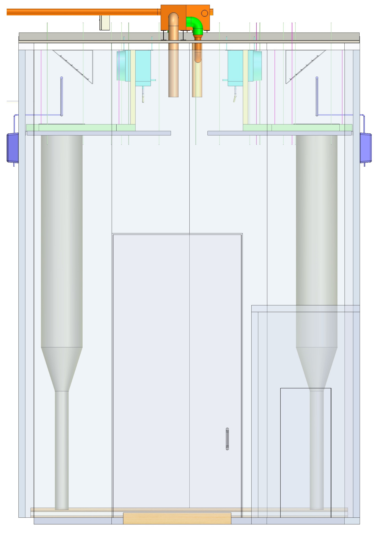
Air Flow
Figure 1. LHC General Air Flow

Slide 2
Heating
Cooling
Return
Figure 2. LHC Heating and Cooling

Slide 3
Wetting
Drying
Return
Figure 3. LHC Wetting and Drying

Slide 4
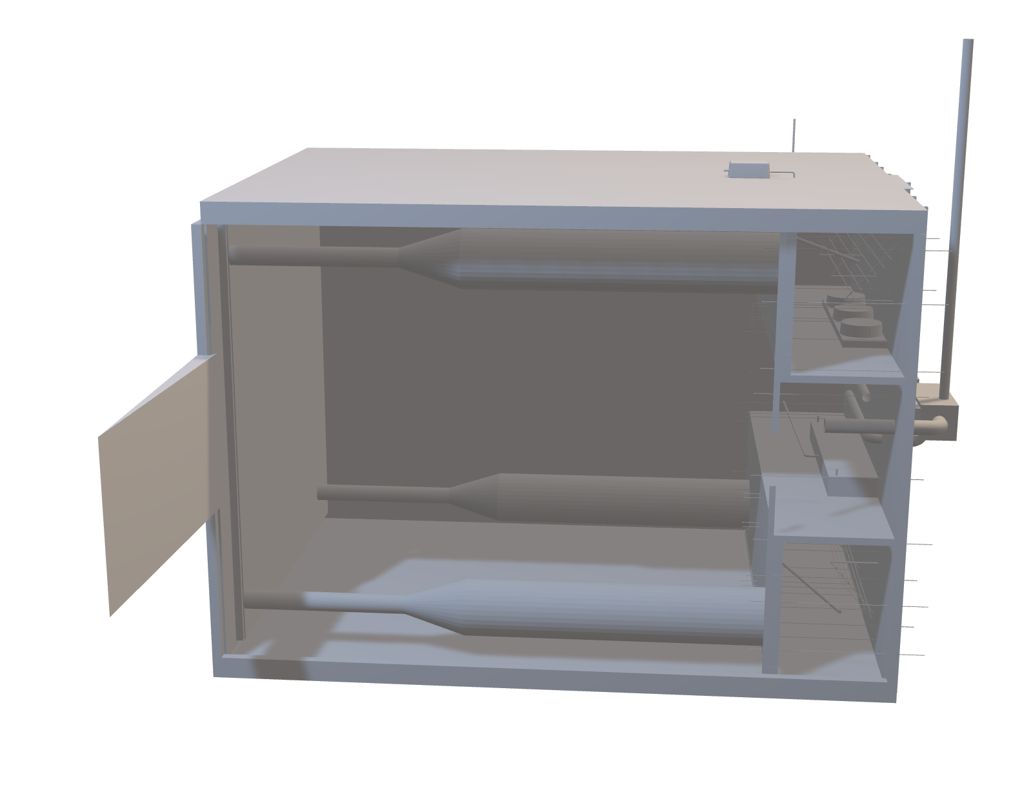
Figure 4. Interactive 3D Model

